Slide 1
PRODUCT DISSECTION

Slide 2
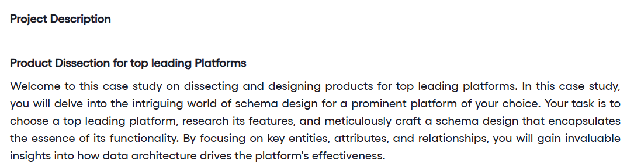

Slide 3
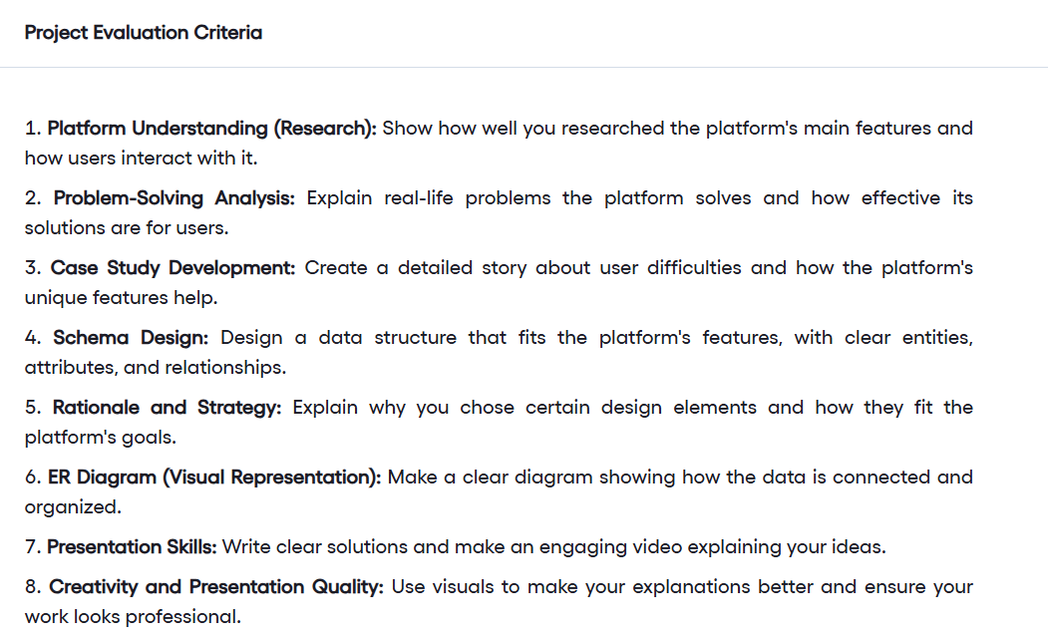

Slide 4
https://drive.google.com/file/d/1govnRqt3-eifuLfoL-X5aFbHzw2uv8HI/view

Slide 5
Break till 7.30pm

